Slide 1
Customer Analysis and Predictive Modeling for Term Deposits
Presented By:
Vishal Khomane

Slide 2
Problem Statement:
Client: Major Middle Eastern Bank
Challenge:
Identify customers most likely to opt for a term deposit and provide this list to the call center for targeted outreach.
Objective:
Analyze customer data to uncover key factors influencing term deposit subscriptions.
Build a predictive model to estimate the likelihood of customers subscribing to a term deposit.

Slide 3
Data Overview:
Customer Data
This dataset contains demographic information about the customers.
Dataset Size: 45,211 records and 7 features.
Transaction Data
This dataset contains transactional information and customer interactions related to term deposits.
Dataset Size: 45,211 records and 14 features

Slide 4
Data Analysis & Visualization

Slide 5
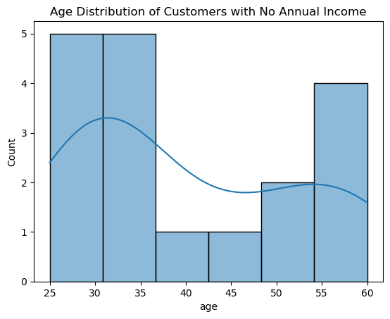
Income Insights:
Objective: Identify how many customers have no annual income and present the data distribution of these customers.
Number of Customers with No Annual Income = 18

Slide 6
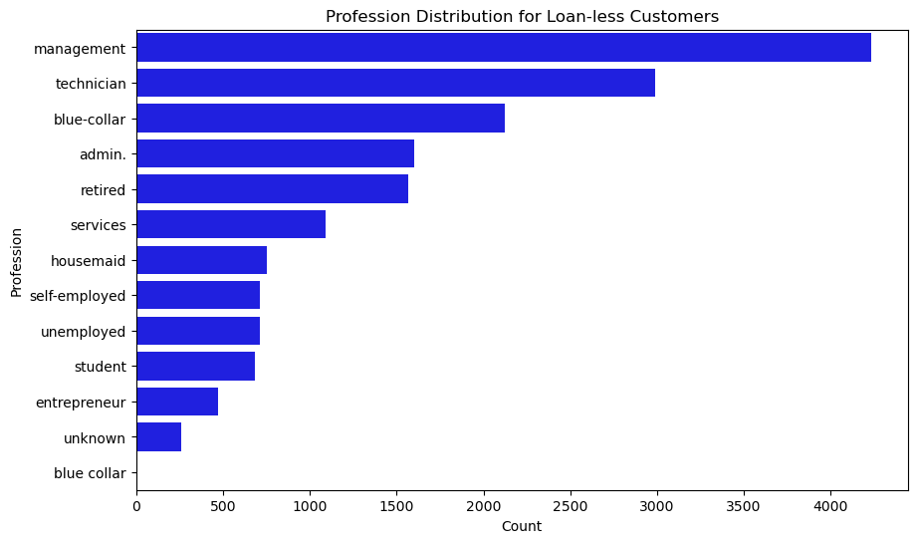
Loan-less Customers Profile:
Objective: Indentify the customers who don’t have any type of loan.
Total number of Loan Less customers = 17201

Slide 7
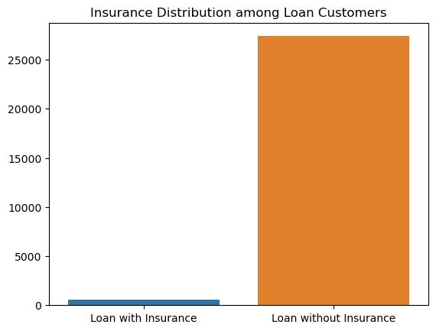
Loan and Insurance Analysis:
Objective: Calculate the percentage of customers with a loan who have taken out insurance.
Percentage of customers with loans who have insurance = 2.15 %

Slide 8
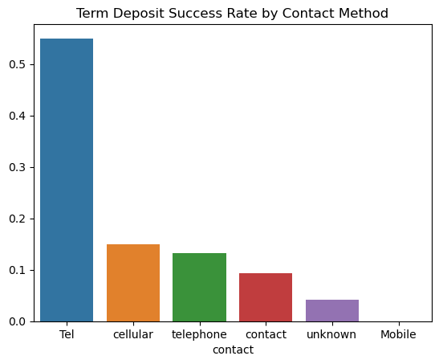
Communication Strategy Insights:
Objective: Analyse and summarize the best Contact method to contact people to ascertain the status of term deposit subscriptions.
Best contact method = Cellular (14.91 %) (29280 Times)

Slide 9
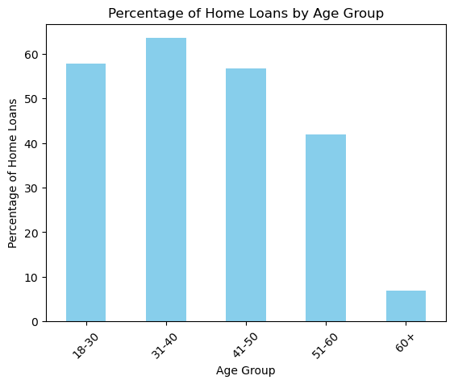
Age and Home Loans:
Objective: Identify which age group has the highest percentage of home loans.
Age Group = 31- 40 (63.50)

Slide 10
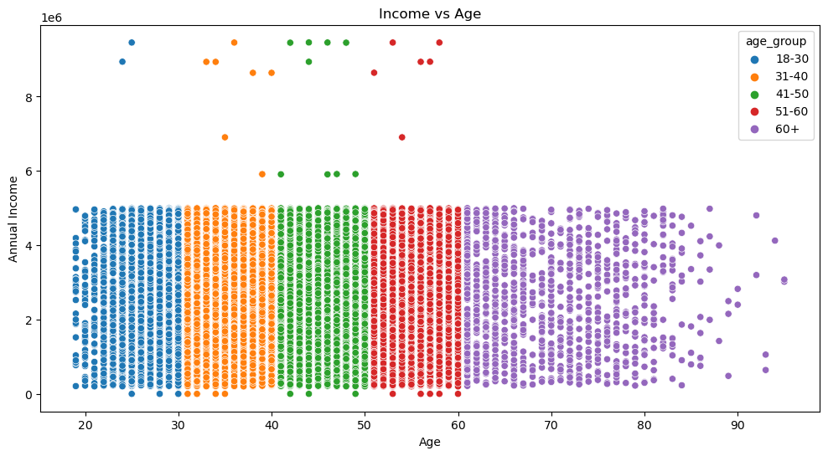
Income and Age Relationship:
Objective: Investigate any relationships between annual income and age group
Correlation between Age and Annual Income = 0.0

Slide 11
Modeling

Slide 12
Term Deposit and Related Variables:
Correlation Analysis:
Pearson Correlation Coefficient: Measured the linear relationship between numerical features and Term Deposit.
Higher absolute values indicate stronger relationships
Categorical Variables:
Label Encoding + Model: Converted categorical variables into numerical form using label encoding or one-hot encoding.

Slide 13
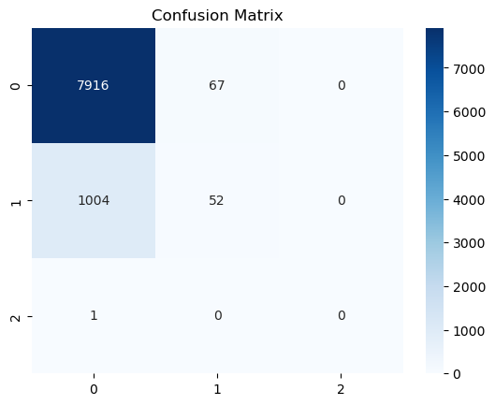
Predictive Model Building:
Logistic Regression:
Train Accuracy: 0.8883969338904724
Test Accuracy: 0.8929717764250138
KNN Classifier:
Train Accuracy: 0.909677062290727
Test Accuracy: 0.8869950193691201
Random Forest Classifier:
Train Accuracy: 0.9999723436030754
Test Accuracy: 0.8814159292035398

Slide 14
Model Improvement Strategies:
Feature Engineering:
Create New Features:
Interaction Features: Combine existing features to create new ones.
Feature Selection:
1. Filter Methods:
Satistical Tests:
Chi-Square Test: For categorical features, it assesses the independence between each feature and the target variable.
ANOVA F-Value: Compares the mean of the feature groups with respect to the target variable (for regression problems).
2. Wrapper Methods:
Backward Elimination:
Stepwise Selection:

Slide 15
Algorithm Selection:
Different Algorithms:
- Gradient Boosting Machines (GBMs): Includes XGBoost, LightGBM, and CatBoost, which are powerful for handling structured data.
- Neural Networks: Deep learning models can capture complex patterns but require more data and computational resources.
Hyperparameter Tuning:
- Grid Search: Systematically test different combinations of hyperparameters.

Slide 16
Data Preprocessing and Feature Engineering:
Feature Scaling:
- Normalization: Scale features to a specific range (e.g., 0 to 1) if needed.
Cross-Validation:
- K-Fold Cross-Validation: Use k-fold cross-validation to assess the model's performance more robustly.
Feature Extraction:
- Use techniques like PCA (Principal Component Analysis) to reduce dimensionality while retaining important information.

Slide 17
Thank You.

